Slide 1
Operating systems

Slide 2
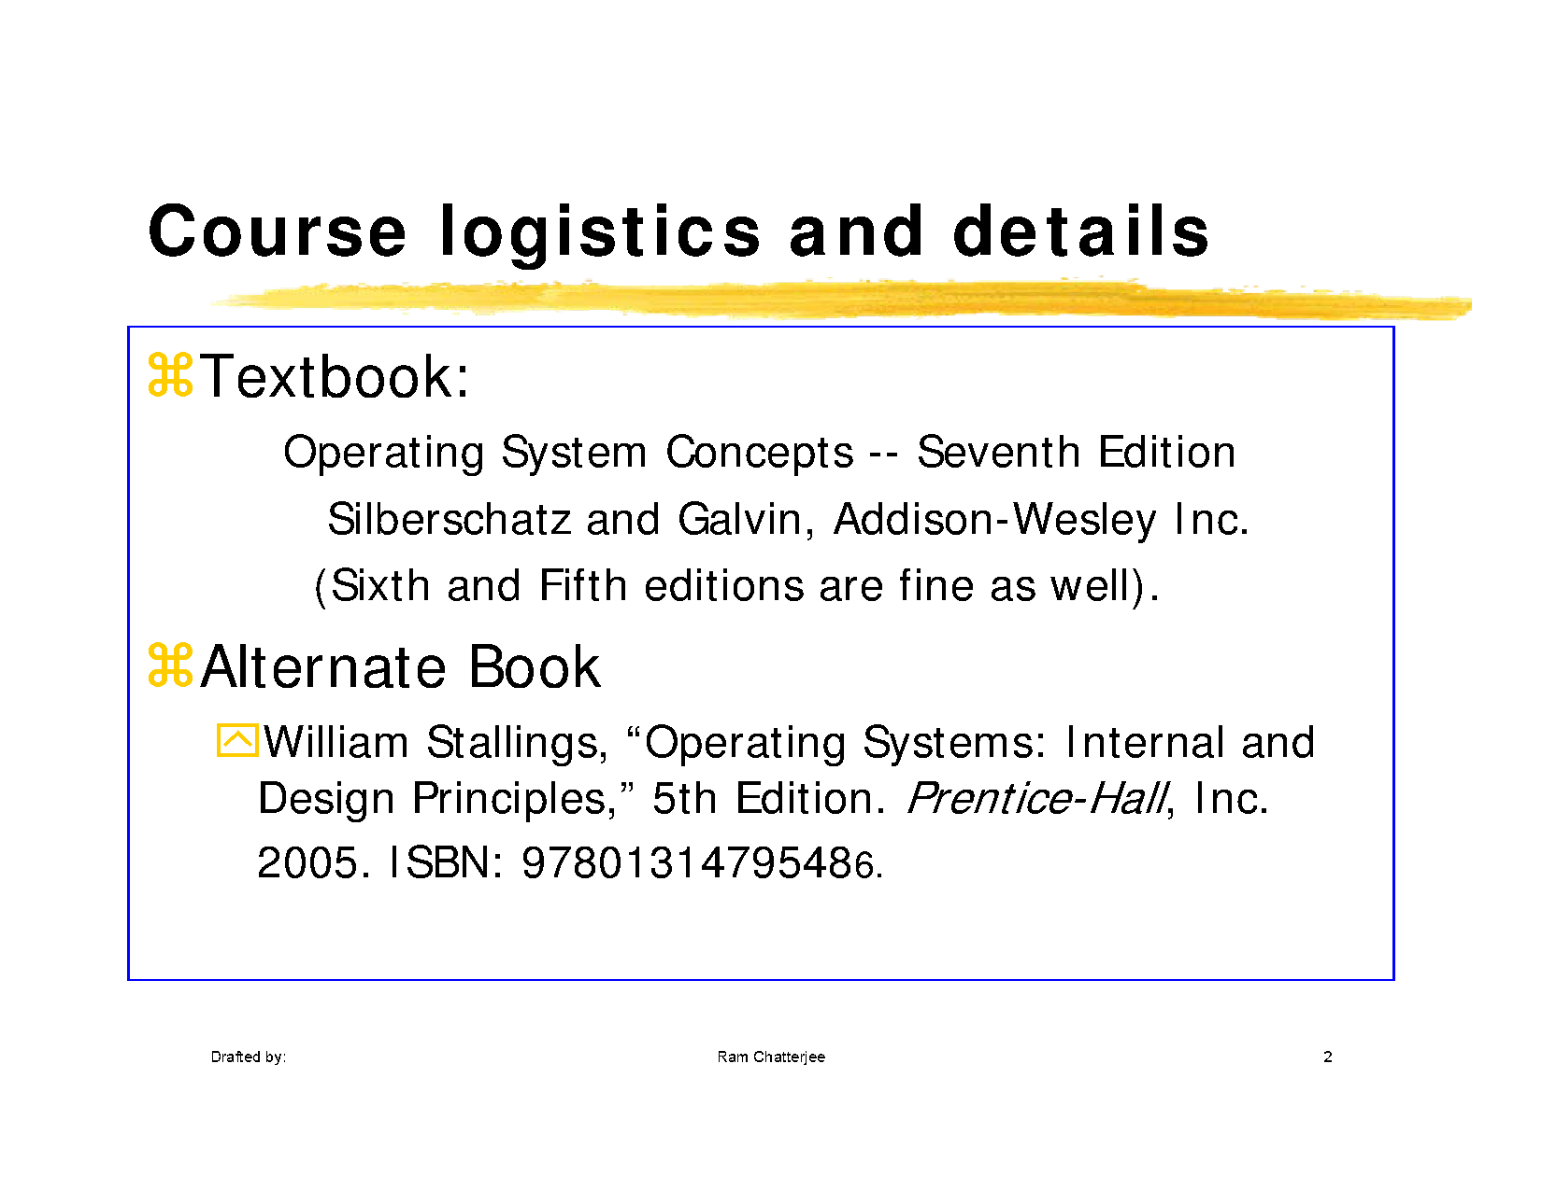

Slide 3
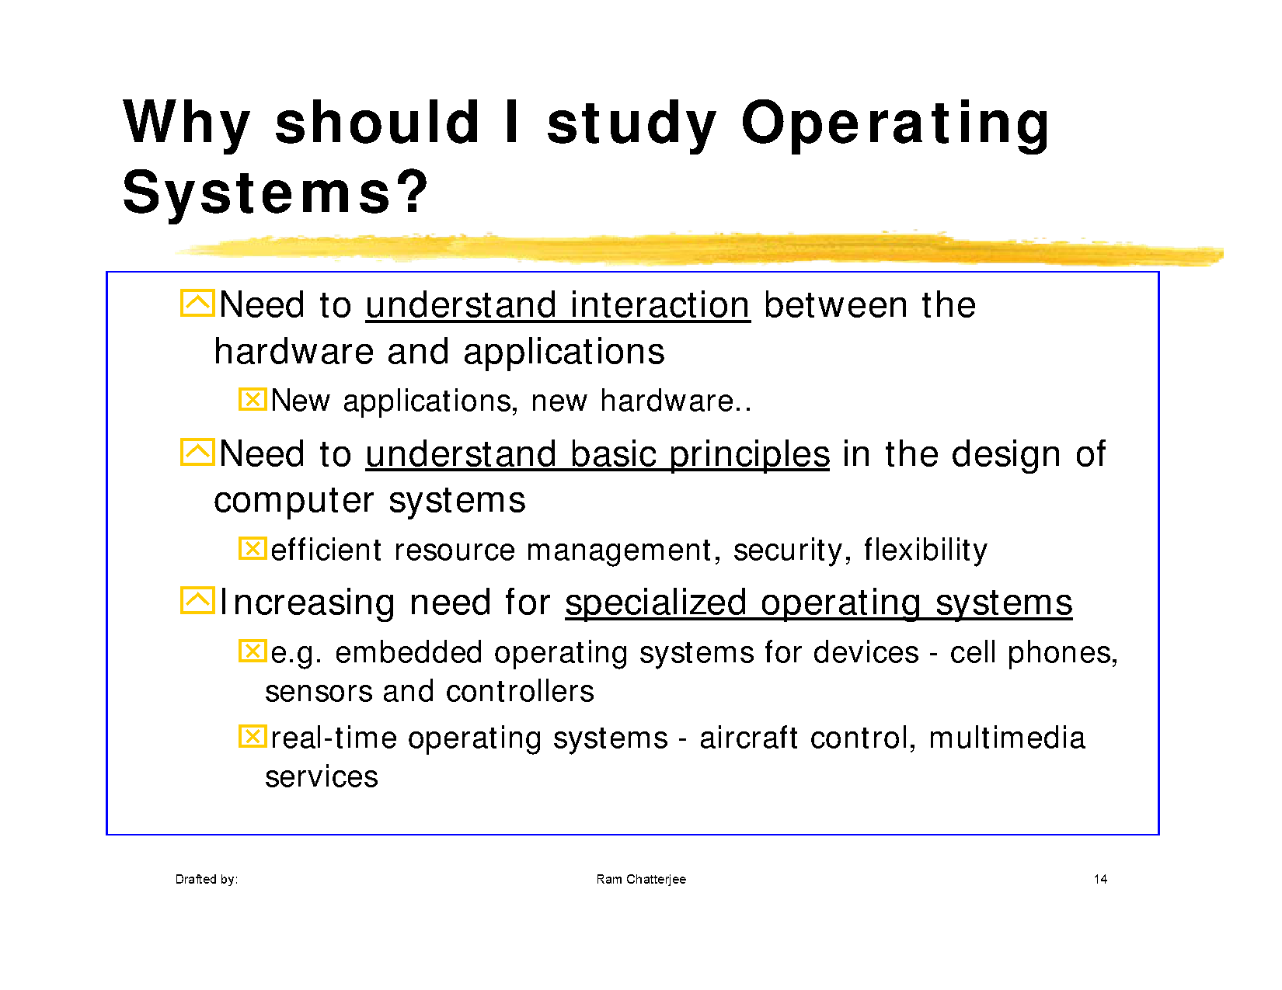

Slide 4
Evolution of Operating systems
First generation (1940s-1950s)
It was the era of vacuum tubes, plug boards and punched cards.
Programmer used to interact with the machine directly through punched cards and used to write the programs in machine language
All the tasks for executing a program would be performed by the programmer only
There was no help like PL, linker, loader etc.
Obviously, there was no operating system

Slide 5
Second Generation (1950s-1960s)
Transistors based technology, mainframe computers, line printers, magnetic tapes, assemblers, linkers, loaders, compilers, FORTRAN, COBOL
Steps:
loading the compiler tape of the required compiler
Reading from card reader
Running the compiler
Unloading the compiler
Loading the assembler tape
Running the assembler
Unloading the assembler tape
Loading the object program
Running the object program

Slide 6
Problems and development of OS
Set up delay problem due to loading and unloading of tapes in earlier computer system
CPU was idle
Jobs of users prepared with same PL were batched together
Automated Job Sequencing ( turning point)
Resident Monitor ( had to be in memory forever)
Problem in Batch Systems
I/O devices were electromechanical , on other hand CPU was electronic device
Mismatch between the speed of CPU and I/O devices
Offline operation with magnetic tapes
Tapes were sequential access devices

Slide 7
Third Generation (1960s-1980s)
Problem in 2G: Tapes were sequential access devices
Need to carry separate tape for input and output as their storage capacity was low
Magnetic disk came into existence, as disks were random access devices and of higher storage capacity
IC based technology, Minicomputer

Slide 8
Problems and Development of OSs
Hard disks came into existence
Multi-programming
Multi-programmed batch systems
Spooling( Simultaneous Peripheral Operation Online)
Lack of user-programmer interaction with their jobs in multi-programmed batch systems
Time-sharing multi-user systems
CTSS (Compatible Time Sharing System)
MULTICS (Multiplexed information and Computing Service)
UNICS (Uniplexed Information and Computing Service)
UNIX
UNIX written in C

Slide 9
Fourth Generation (1980s-Present)
LSI and VLSI based technology
Microcomputer (later named as PCs)
Intel 8080 was the first Microprocessor for PC

Slide 10
Problems and Development of OSs
Gary kildall in Intel designed an OS called CP/M (control program for micro computers) for PCs
MS-DOS
Multiuser facility were not there in DOS
XENIX
OS/2
No user friendliness and convenience due to command driven and complex file systems
Apple Macintosh
Windows
Multi-tasking
Multi- threading
UNIX developers lacking GUI ….X Windows, Motif
Network Operating Systems
Distributed Operating Systems

Slide 11
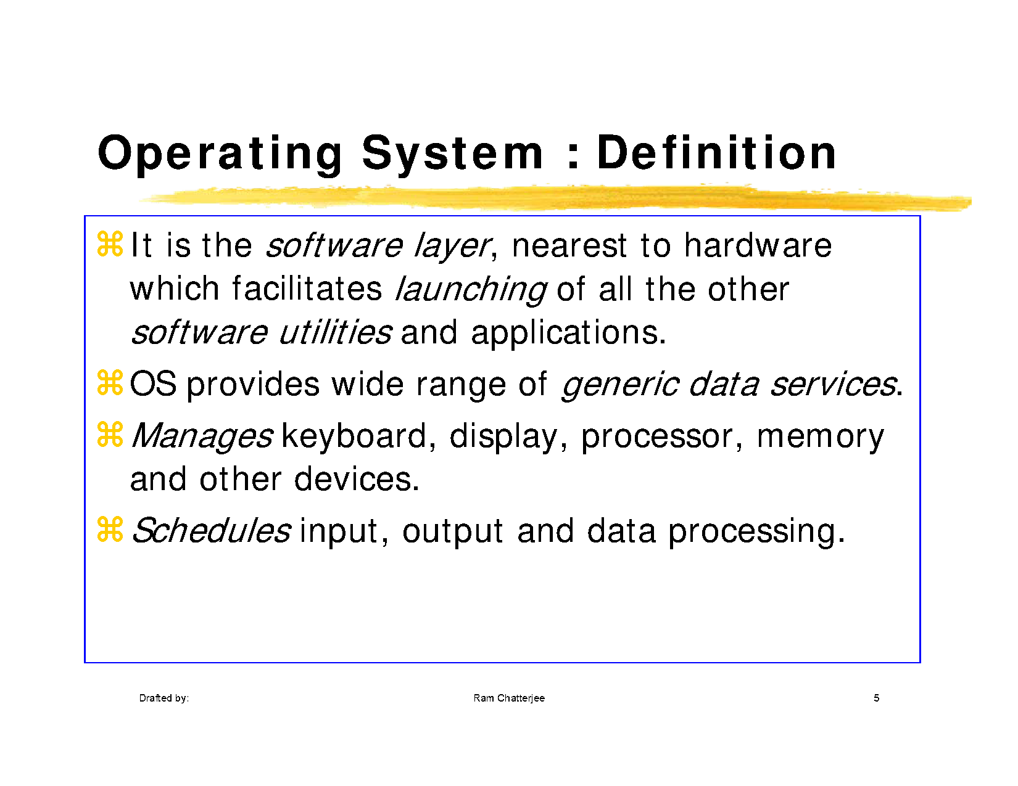

Slide 12
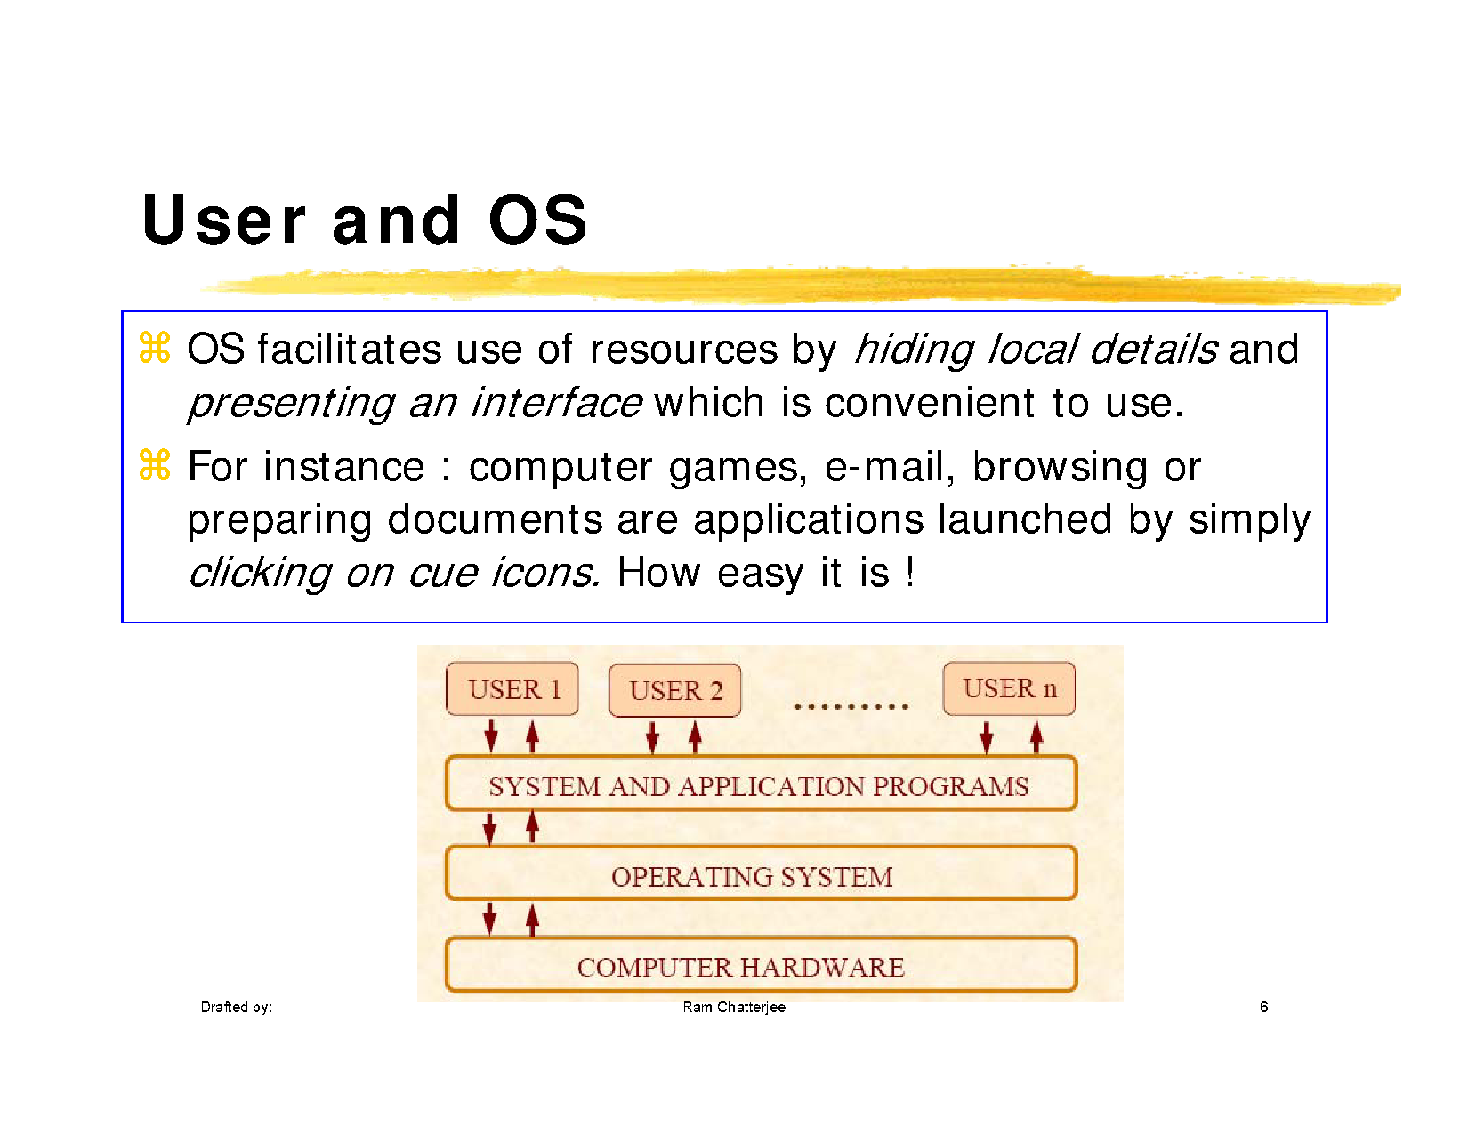

Slide 13
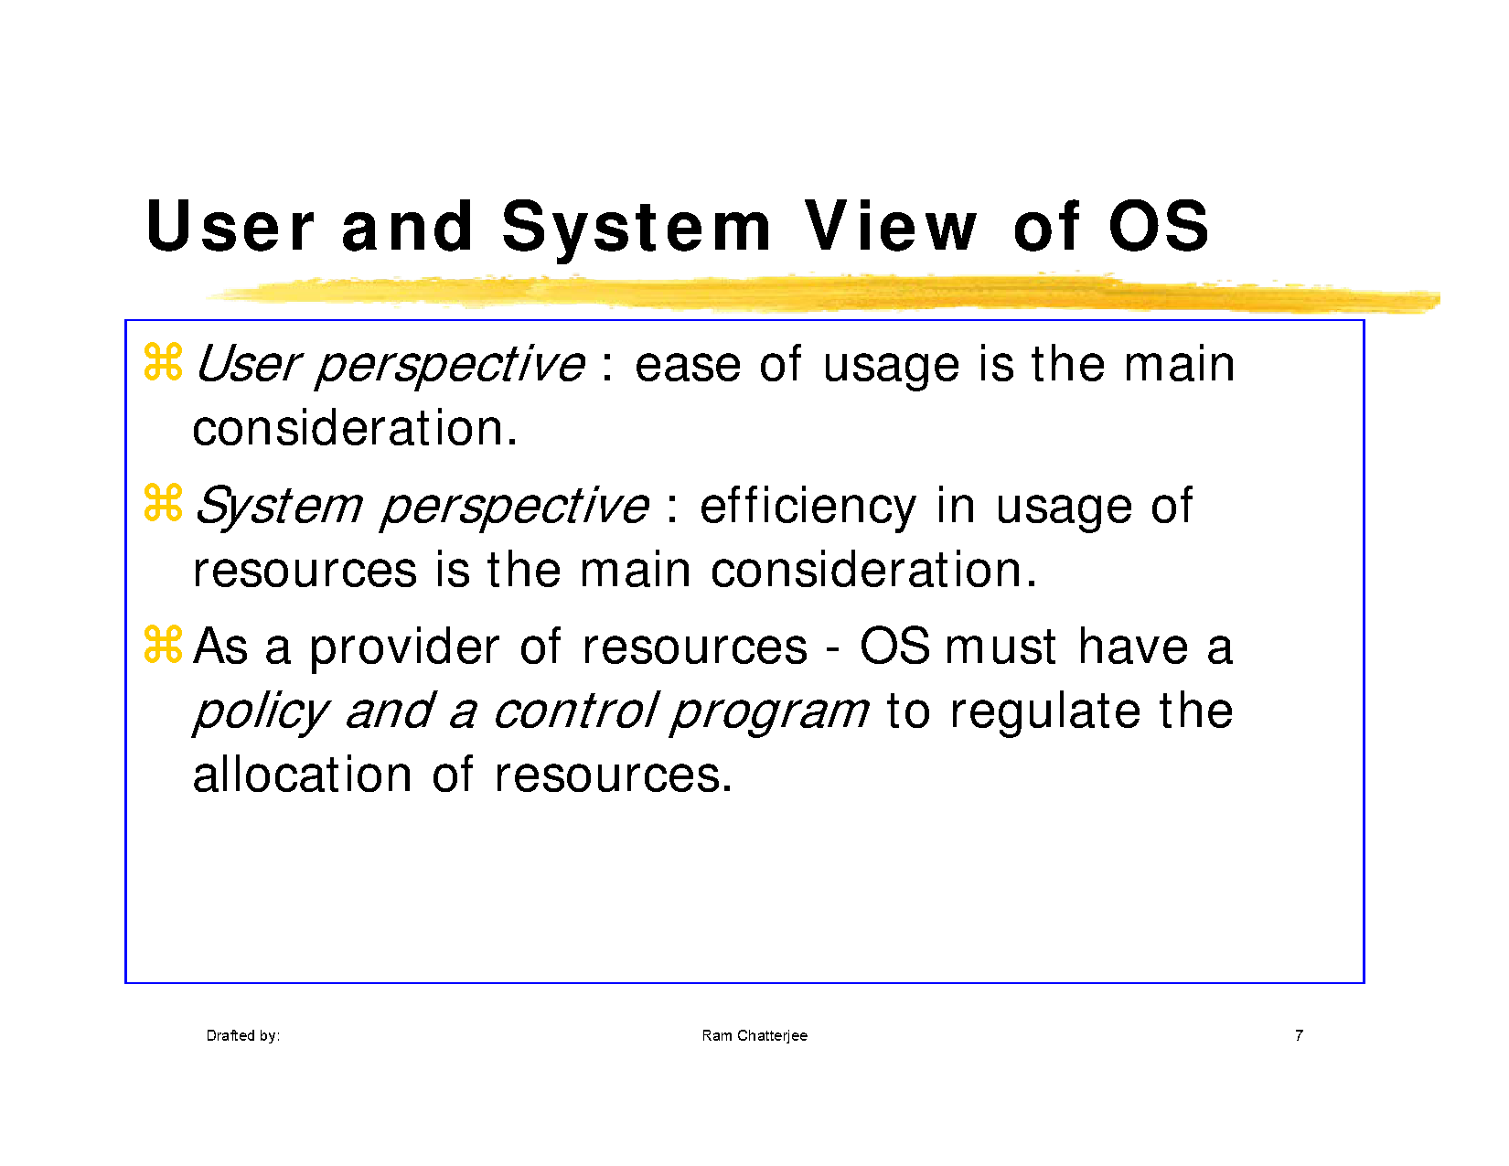

Slide 14
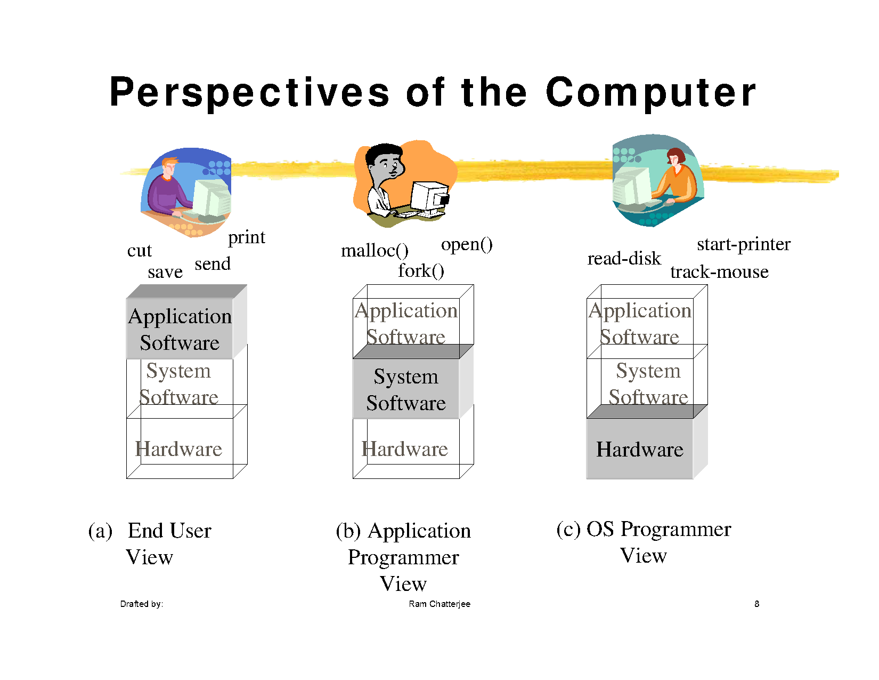

Slide 15
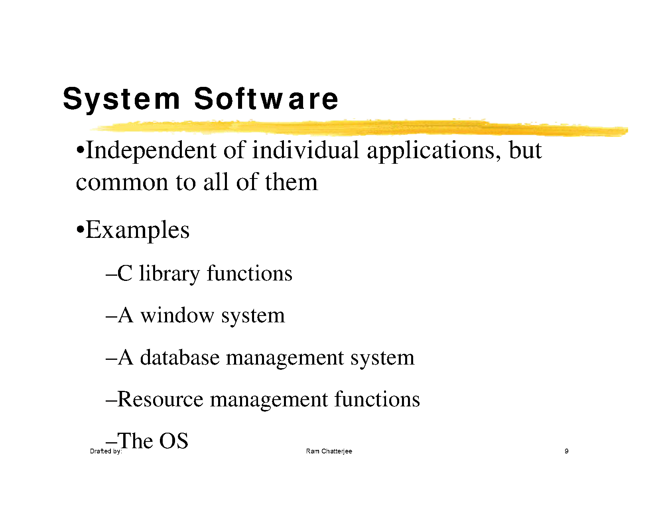

Slide 16
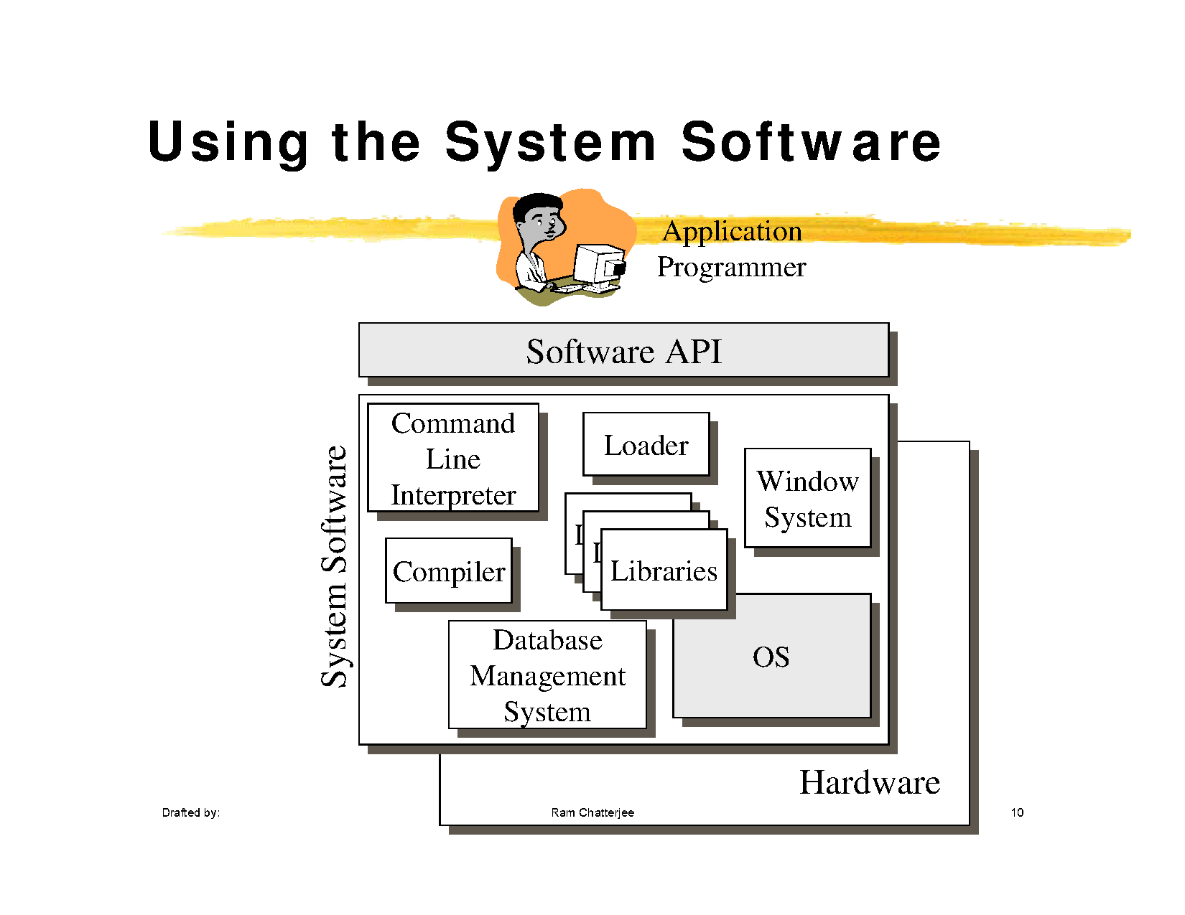

Slide 17
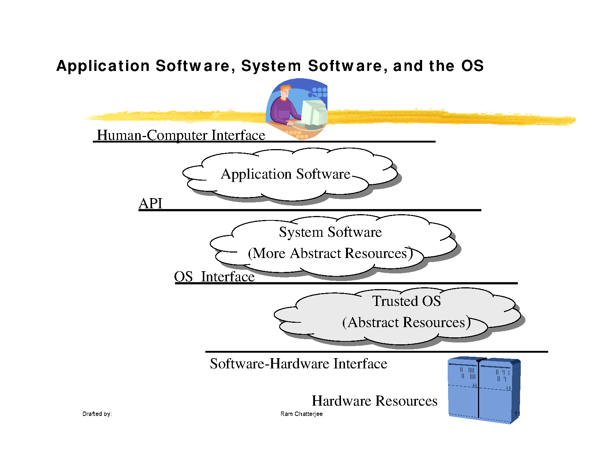

Slide 18
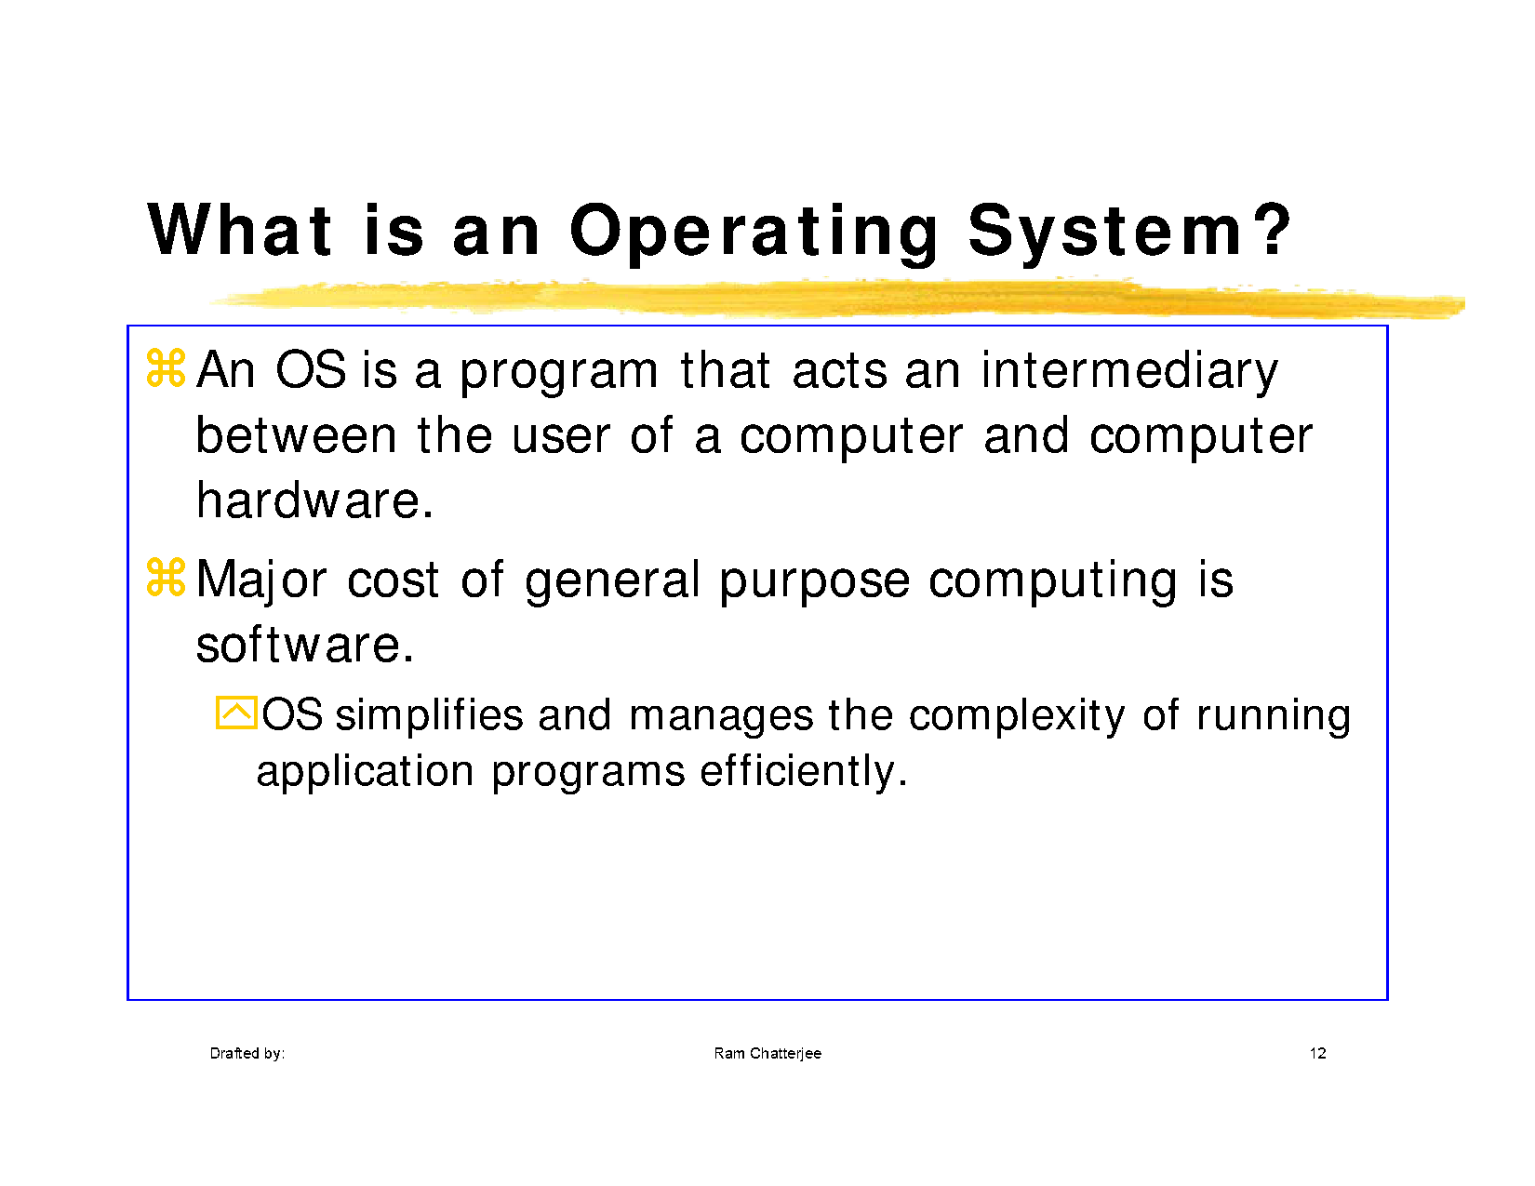

Slide 19
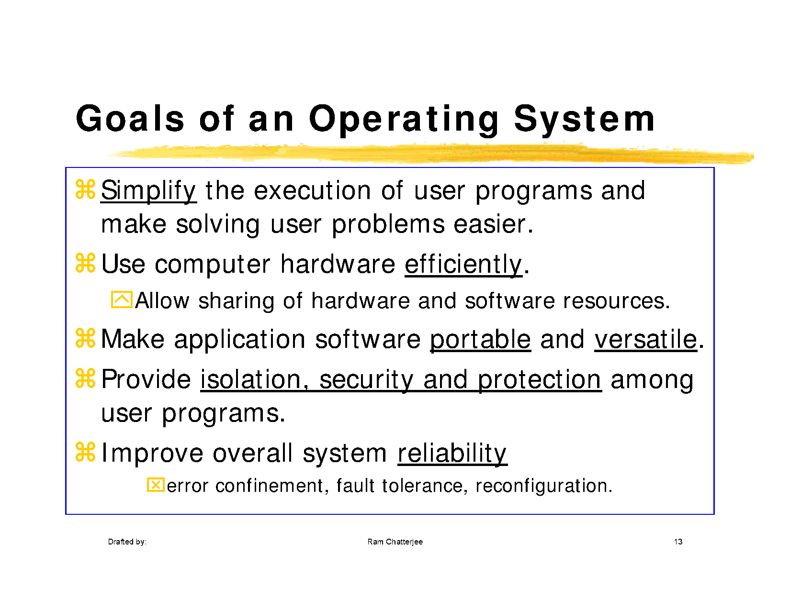

Slide 21
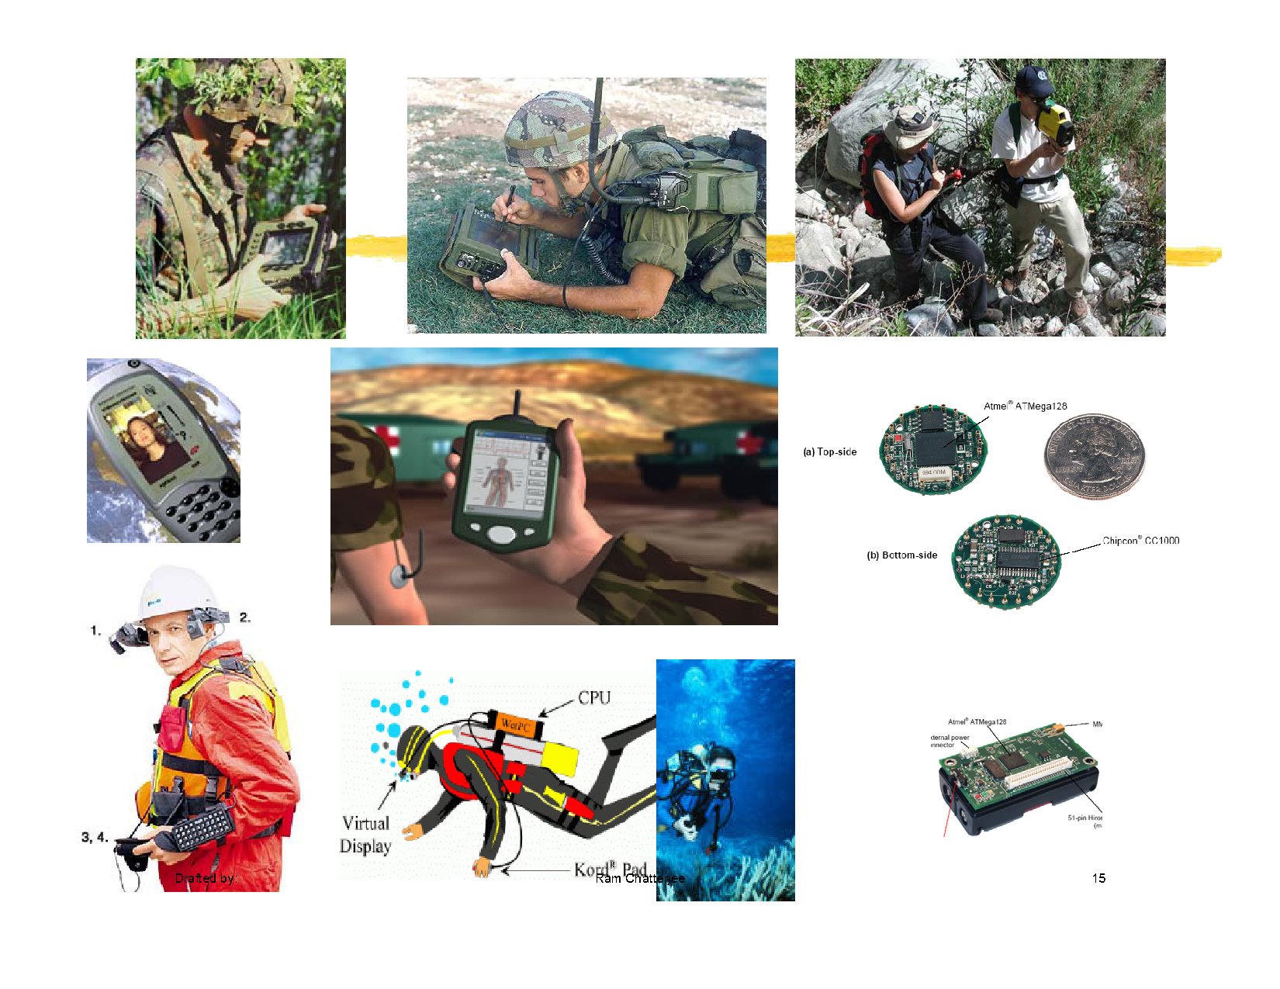

Slide 22
Types of Operating System
Batch Processing systems
Multi-programming systems
Multi-user Time sharing systems
Multi-tasking systems
Network Operating Systems
Multi- Processor Operating Systems
Distributed Operating Systems

Slide 23
Batch Operating Systems
Were developed as a result of more set-up time for execution of different types of user programs
Can be used for user jobs which do not require user intervention
Main advantage of batch processing is to increase the CPU utilization
It is not meant for a quick response to the users, but it is still used to quantify the user service turnaround time
The time since the job was submitted to the system to the time when the user gets the result back

Slide 24
Multi- programming systems
Multi programming means to place several programs or jobs in main memory instead of a single program
Two types of instruction in a program :
CPU bound and I/O bound
CPU has an instruction for processing or computation
There is a request to an I/P or O/P device to read or write

Slide 25
Benefits of Multi-programming
Less execution time : spooling and switching between the jobs frequently by CPU
Increased utilization of memory : instead of storing a single program in memory, more than one program is stored thereby utilizing the main memory
Increased throughput
Throughput= No of jobs completed per unit time
Throughput is increased if degree of multi
programming is increased

Slide 26
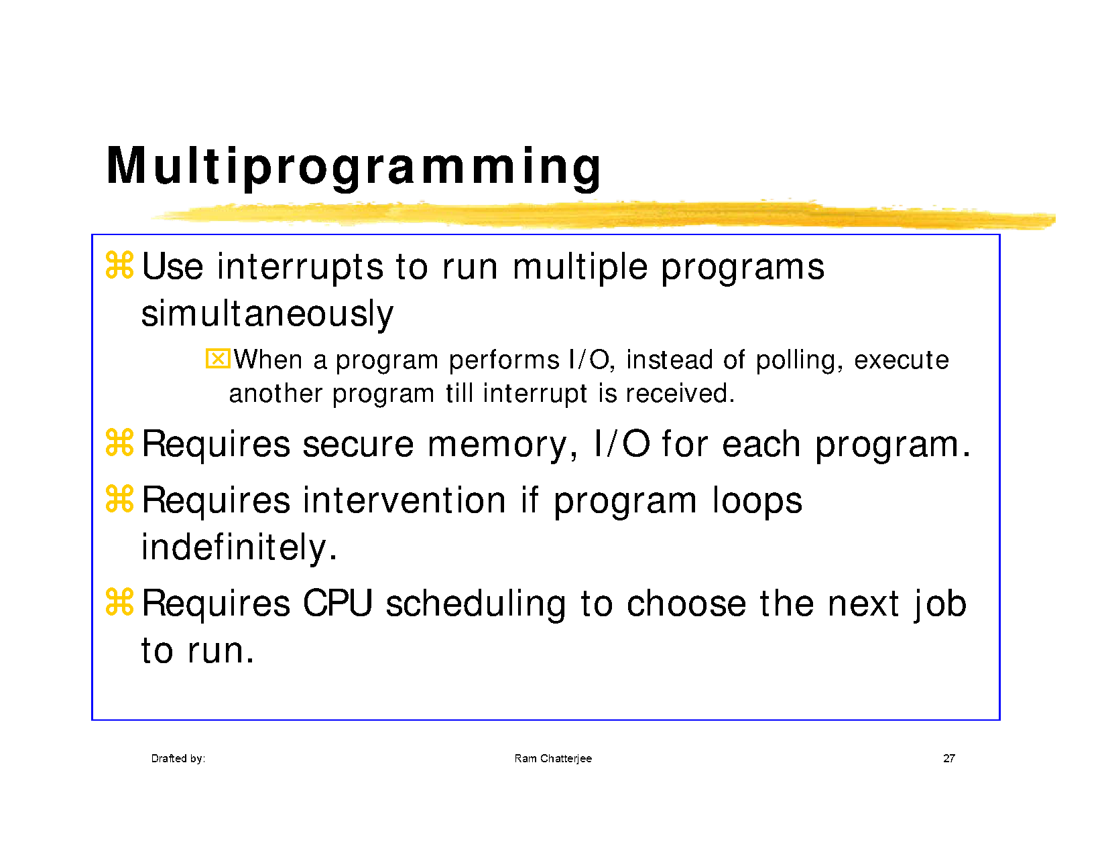

Slide 27
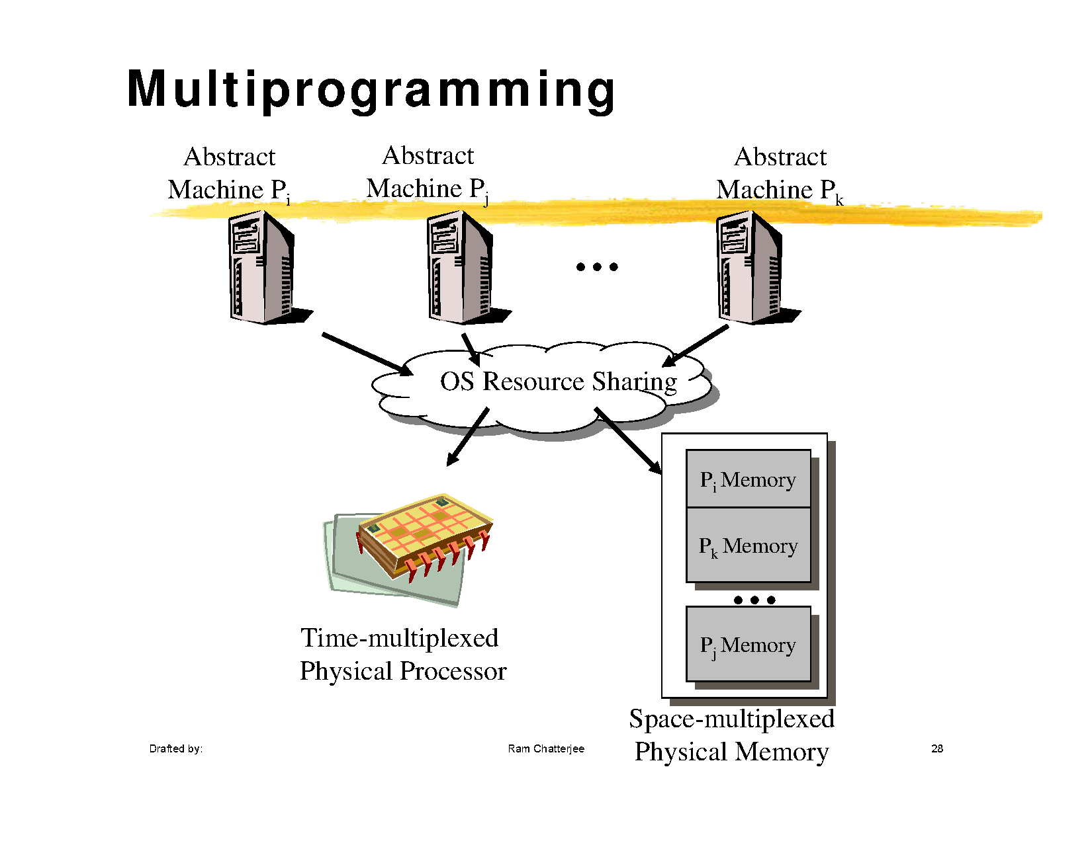

Slide 28
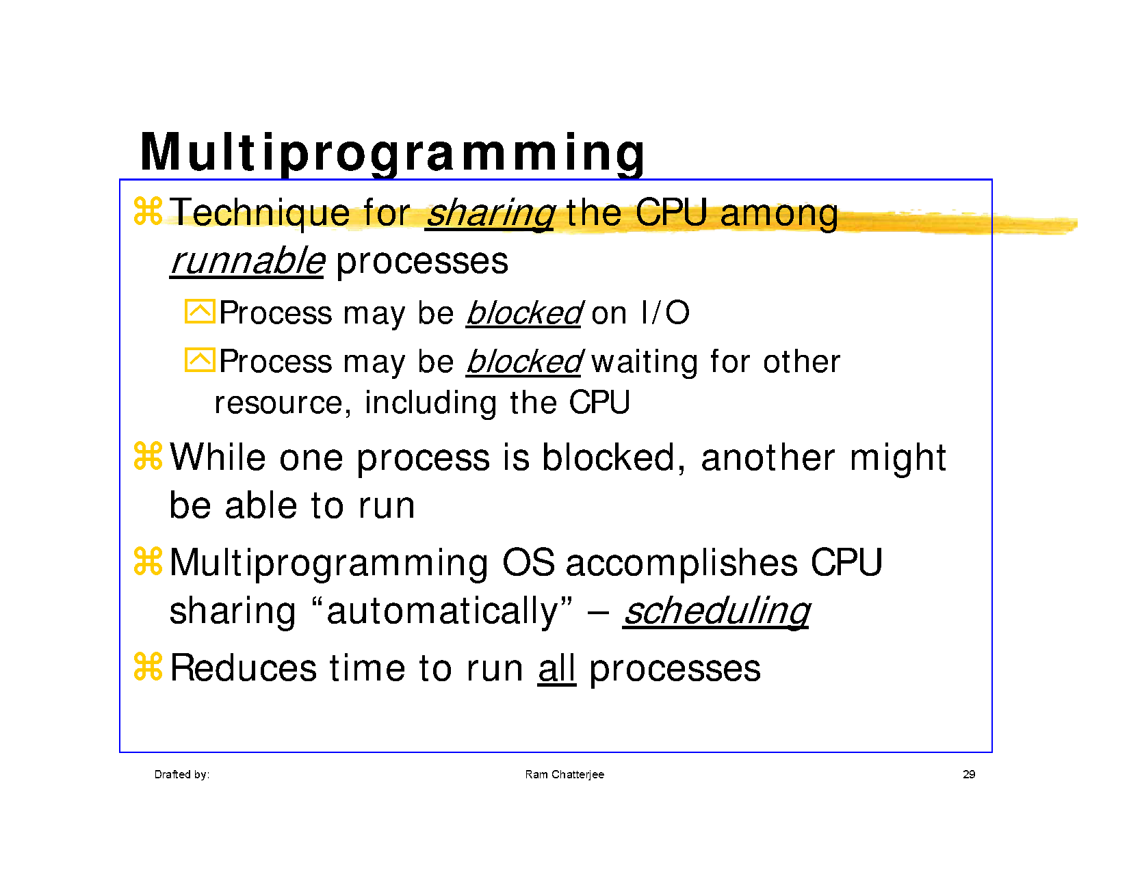

Slide 29
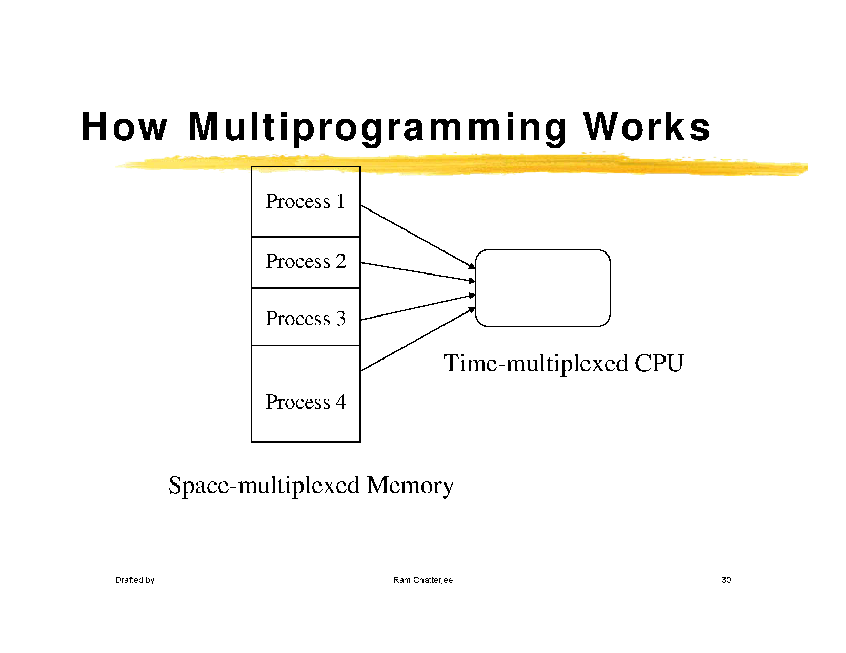

Slide 30
Multi user Time sharing system
Batch and multi- programmed batch systems do not provide immediate response to the user
If one user submits his/her job, he/she has to wait for the execution of all the jobs in the batch and then get the output
Waiting time of a user is more and he/she is not in direct touch with his/her job
Problem is due to non-interactive input and output devices

Slide 31
Interactive devices like keyboard and video terminals
Another paradigm, Multiple users with their terminals ( having no processors) were connected to computer system (with processor) to perform their jobs
Jobs of multiple interactive users were placed in main memory instead of batched jobs
Multiuser as it supported multiple interactive users
Time sharing as CPU time of main computer system was shared among multiple users to execute their jobs
Multiple interactive users connected through their dumb terminals access the main computer system to perform their jobs

Slide 32
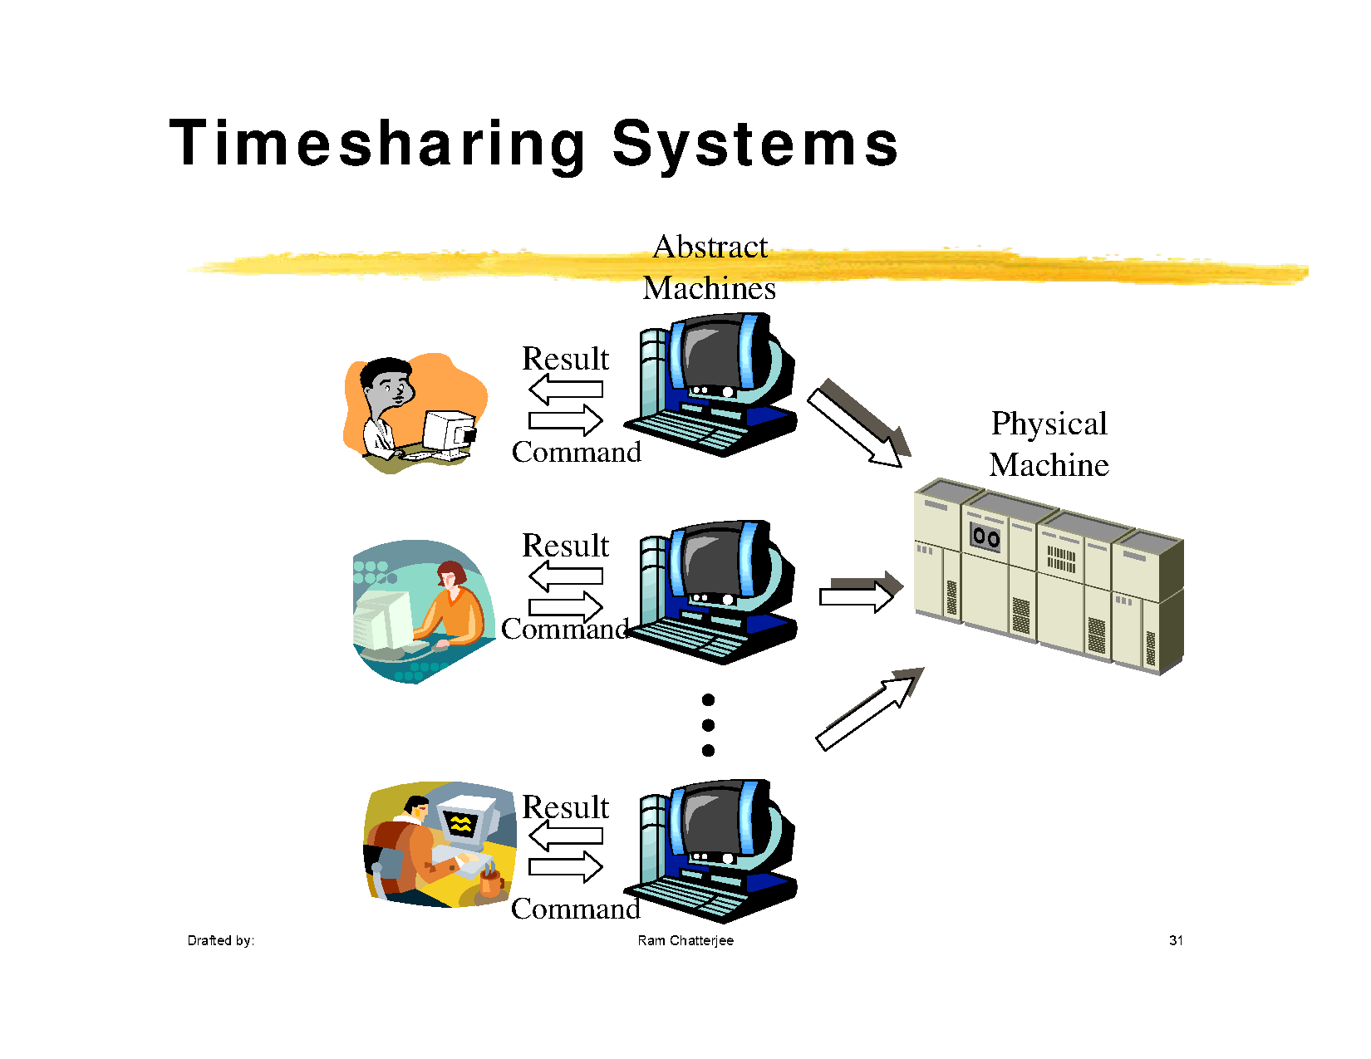

Slide 33
Benefits
Multiuser facility: multiple users connected to a single system where each user presents the job to the system and gets the response
Improved response time : user now is in direct touch of his job and due to easy interface, he views everything regarding his job
Improved Debugging and Productivity : user can view his mistake, debugging of programs is easy. Quickly modifies program and run again, thereby increasing productivity also

Slide 34
Multi tasking systems
Time sharing and multi tasking are also used interchangeably
Multi user and multi tasking are different terms, and time sharing is the scheduling technique in both of them

Slide 35
Multi-programming : place more than one job/ program/task in the main memory
Multi programmed Batch system : place more than one job/ program/task in the main memory of a batch prepared for same type of jobs, and execute them by switching them
Multiuser System: place more than one job/ program/task in the main memory of the main computer system. Here jobs come from the different users who are connected through terminals to the main computer. Jobs are scheduled by time sharing technique

Slide 36
Multi tasking systems : place more than one
job/program/task in the main memory of the
system. The jobs here are of a single user working
on the system. Jobs are scheduled by time sharing
technique

Slide 37
Network Operating System
This system coordinates the activities on a network system
In a network each node has its own local operating system
User is able to connect to another machine and perform many operations
User must be aware of the location of the network node where he/she wants to connect
When a user wants to remote log onto a system, wants to transfer a file etc. on a network system

Slide 38
User may perform both local and non local operations
Non-local operations, the role of network operating system starts
NOS may be considered as another layer of software on the operating system on a local machine

Slide 39
Distributed Operating system
Works in a WAN
Each node in a distributed system is a complete computer having full set of peripherals including OS
Main motive is resource sharing
Users are not aware where their processes are being sent and executed

Slide 40
Tasks to be met by DOS
Three types of migration
Data migration transferring data from one site to another site
Computation migration transferring the computation on a particular node
Process migration the process or its sub processes may also need to be transferred to some other nodes due to some reasons like load balancing, computation speed etc

Slide 41
DOS must provide the means for inter process communication
RPC A process on one node may invoke a function or procedure in a process executing on another node
RMI allows a java process to invoke a method of an object on a remote machine
CORBA is a standardized language that supports different PLs and different DOSs for distributed communication
The Common Object Request Broker Architecture (CORBA) is a standard defined by the Object Management Group (OMG) designed to facilitate the communication of systems that are deployed on diverse platforms.

Slide 42
Real time systems
Time sharing system drawback, if more load on system, response time was further increased with increase in load
Some systems cannot bear delay.
Used to handle time bound responses to the applications
Applicable to systems which require time bound
response, i.e. for real time processing systems ( immediate or within a fixed time frame)

Slide 43
Examples :
Defense applications like guided missile systems, air traffic control systems
Two types
Hard real time system : have hard deadlines and must be met
Soft real time system : missing of some deadline is acceptable. E.g. digital audio, multimedia systems, virtual reality
Delay here must be bounded and predictable and should not be infinite

Slide 44
Embedded systems
Specialized systems with size, memory and power restrictions
Used in consumer electronic items, mobile phones, smart cards etc.
Embedded systems also have OS but they are not generalized ones
User uses these devices without any awareness of operating system

Slide 45
Embedded Oss are there to perform all the basic functionalities like initialization, task management, memory management etc.
There are OS, but not in the same structure as in general purpose computer systems

Slide 46
Oss generic components
Hardware
Kernel
Shell
System and application programs
user

Slide 47
Kernel : A kernel is the central part of an operating system. It manages the tasks of the computer and the hardware - most notably memory and CPU time.
Command interpreter or shell : A program which reads and interprets the control statements and passes the signals to operating system

Slide 48
Kernel types
Monolithic
Microkernel

Slide 49
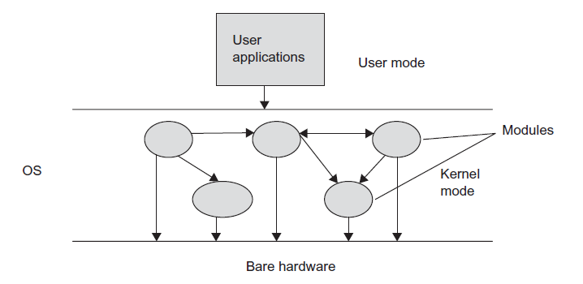
MONOLITHIC ARCHITECTURE
Therefore, all the functionalities were added in the kernel only. The advantage of this type of architecture was that intercommunication between the modules of the OS was
efficient, as all the modules were in the kernel together

Slide 50
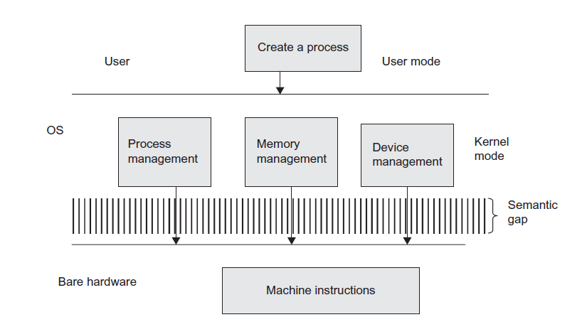

Slide 51
MONOLITHIC ARCHITECTURE
Due to all functionalities merged in a single layer, it was difficult to do modifications in a module.
debugging in the modules of the OS became a difficult job.
Another disadvantage of this architecture was that there was no protection.
Monolithic systems were not suitable for multi-programming/multi-tasking environments due to unprotected behavior of the system.
The DOS, initial architecture of UNIX, and Linux are some examples of monolithic structures.

Slide 52
MICROKERNEL ARCHITECTURE
To remove heavy functionalities from the kernel, it was thought that some essential functionality will remain inside the kernel known as essential core of the OS code.
The kernel, consisting of essential core, is called microkernel.
The components of the essential core may be process management, inter-process communication, low-level memory management, and so on.
The other OS modules, which were considered as non-essential, were moved up in the user space. In this way, microkernel was designed to manage the large-size kernel by dividing it into two parts:
kernel space code and user space code.

Slide 53
MICROKERNEL ARCHITECTURE
Developers have discussed features to be included inside the kernel and features to be incorporated in the user space.
The modules implemented outside the kernel in user space are called server processes.
The application programs of the user (client programs) communicate with the server process.
The server processes provide various services like file system management, process scheduling, device management, networking, and so on.
The communication between the client applications and server processes is through the message-passing communication method, called as Inter-process Communication (IPC), also known as client-server architecture of OSs.

Slide 54
MICROKERNEL ARCHITECTURE
Moves as much from the kernel into user space
Mach example of microkernel
Mac OS X kernel (Darwin) partly based on Mach
Communication takes place between user modules using message passing
Benefits:
Easier to extend a microkernel
Easier to port the operating system to new architectures
More reliable (less code is running in kernel mode)
More secure
Detriments:
Performance overhead of user space to kernel space communication

